Slide 1
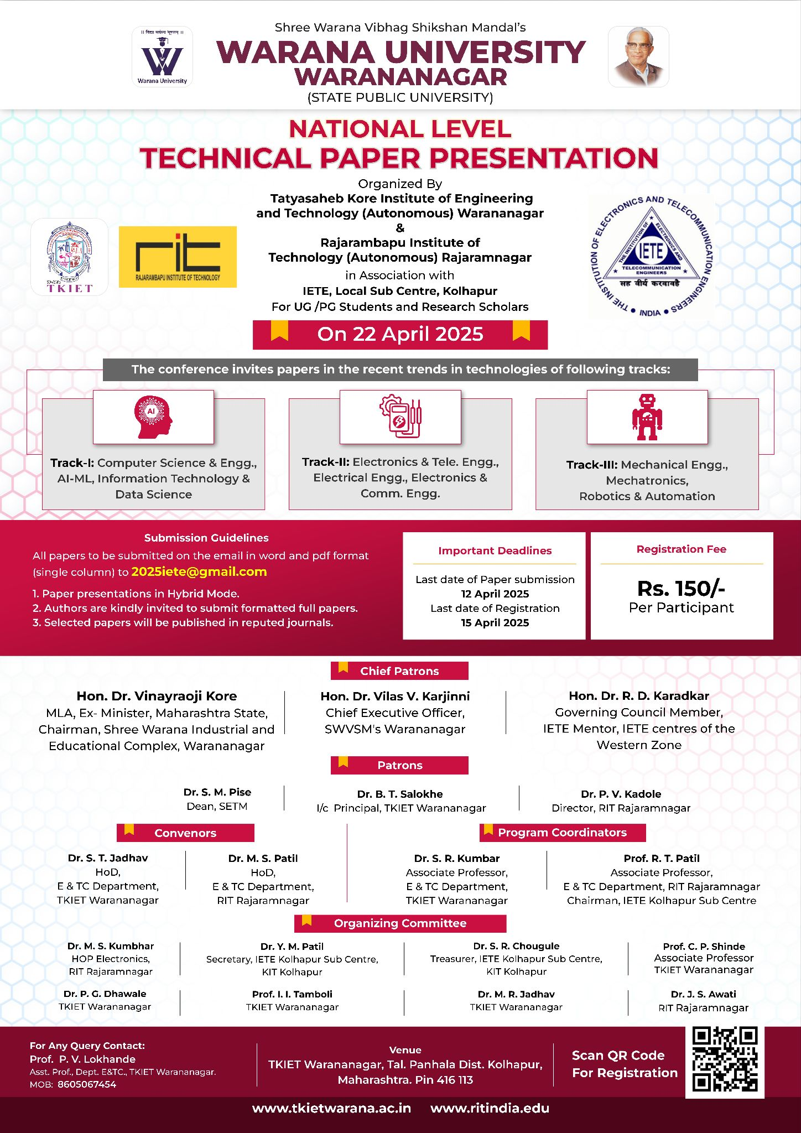
Track Name : IoT and Voice-Controlled Embedded Systems
Paper Title :Voice-Based Hot and Cold Water Dispenser Using ESP8266
Authors : Sakshi Badadhe – EN3003 , Pravin Bangar – EN3004 , Prerana Biradar – EN3006 Asra Dhotekar – EN3012 , Neha Shriwas – EN3048 , Ranjeet Kate – EN3062

Slide 2
Introduction
1.What is the topic about? (Brief Introduction)
This project presents a voice-activated water dispenser system capable of delivering hot or cold water using simple voice commands. It uses the ESP8266 microcontroller, voice recognition module, and relays to automate the process, enabling touch-free control for enhanced convenience and hygiene
.
2.Why did you choose this topic? (Motivation & Relevance)
We were inspired by the need for contactless technology—especially after the COVID-19 pandemic—and the desire to improve accessibility for the elderly and differently-abled. With increasing interest in smart home devices and IoT-based automation, this topic felt both timely and impactful.
3.Objective of the Study (What do you aim to achieve?)
Our goal is to develop a cost-effective, efficient, and easy-to-use water dispensing system that responds accurately to voice commands, ensuring safety, hygiene, and accessibility for users in both domestic and public environments.
4.Real-world Applications (Where is this useful?)
1.Hospitals and clinics for hygienic water access
2.Homes for the elderly and physically challenged
3.Public places (airports, offices, schools) for touchless interaction
4.Smart kitchens and automated appliances
5.Future integration in IoT ecosystems for smart home environments

Slide 3
Literature Review
The use of voice recognition technology in smart systems has evolved rapidly, driven by the demand for touchless, user-friendly interfaces in modern appliances. This has paved the way for innovations like voice-controlled water dispensers. Several researchers have contributed foundational work in this field, which directly influenced the development of our project.
Zhu et al. explored the integration of voice assistants like Amazon Alexa and Google Assistant in smart home environments, emphasizing how Natural Language Processing (NLP) advancements have made these systems more reliable and intuitive for daily use [1]. Their findings underline the importance of voice-controlled technology in improving convenience and accessibility in domestic settings.
Xu et al. focused on the IoT-based automation of water dispensing systems, particularly emphasizing automated temperature control to ensure consistent water quality and minimize user intervention [2]. Their research highlighted the potential of combining IoT with sensor-driven mechanisms, which is central to our design using the ESP8266 microcontroller.
Accessibility was another major theme in related studies. Borsci et al. investigated how voice-enabled systems improve usability for the elderly and differently-abled, proving their significance in inclusive design [3]. This strongly supports our aim to create a dispenser suitable for public and healthcare spaces where manual operation may be challenging.
The importance of energy efficiency in smart devices was examined by Wang et al., who proposed systems that utilize intelligent shut-off mechanisms to reduce power consumption and avoid unnecessary energy use [4]. Their research influenced our inclusion of auto cut-off features in the heating and cooling mechanisms.
To better understand the underlying technologies, we referred to the work of Jurafsky and Martin in their book Speech and Language Processing, which provided in-depth knowledge of speech recognition algorithms and how they can be embedded in microcontroller-based systems [5].
Despite these advancements, certain research gaps remain. Most existing work focuses on generic smart appliances with limited application in real-world water dispensing systems. Furthermore, offline voice recognition modules, which offer privacy and work without internet connectivity, are underutilized in current literature. Additionally, very few studies attempt to combine voice control, hygiene, accessibility, and energy efficiency into a single, cost-effective solution. Our project aims to bridge this gap by integrating all these aspects in a functional prototype using accessible hardware and software

Slide 4
Problem Statement
Problem Statement
In today’s world, access to clean and temperature-controlled drinking water is essential in homes, offices, healthcare facilities, and public places. However, most conventional water dispensers are manually operated, which not only limits their usability for elderly individuals or people with physical disabilities, but also poses hygiene risks due to repeated human contact — a major concern, especially after the COVID-19 pandemic. Additionally, existing dispensers lack smart integration, offering no support for voice commands, automation, or remote access, and often consume unnecessary energy due to continuous heating or cooling.
Current Challenges / Gaps in Existing Solutions
Lack of Touchless Operation: Most dispensers require physical buttons or levers, which may lead to germ transmission and make them unsuitable for high-sensitivity environments like hospitals.
Poor Accessibility: People with mobility impairments or visual challenges find it difficult to use traditional dispensers.
No Voice Interface: There is limited availability of water dispensers that utilize voice recognition to enhance user interaction and ease of use.
Limited Automation & IoT Features: Existing devices are not smart-enabled, lacking connectivity or automation for energy management and real-time control.
High Cost of Smart Systems: Some automated dispensers are available but are expensive and complex, making them impractical for widespread public use

Slide 5
Methodology
How Did You Conduct Your Study?
We followed a practical experimental approach by building a hardware prototype of the dispenser. The focus was on integrating voice recognition technology with a microcontroller (ESP8266) to control hot and cold water flow based on spoken commands. The system was tested under different conditions to ensure functionality, response time, and user-friendliness.
Tools & Techniques Used
Hardware Components:
ESP8266 Wi-Fi Microcontroller – Core control and IoT connectivity
Voice Recognition Module (Elechouse V3) – For voice input
Relay Modules – To switch pumps and solenoid valves
12V DC Water Pumps – For water movement
Solenoid Valves – To control hot/cold water flow
IR Sensor – Glass detection before dispensing
Power Supply & Voltage Regulators
Software & Platforms:
Arduino IDE – Code development and uploading to ESP8266
C/C++ – For programming the microcontroller logic
Android IDE (planned for future mobile control integration)
Serial Monitor – For testing and debugging sensor/voice module responses

Slide 6
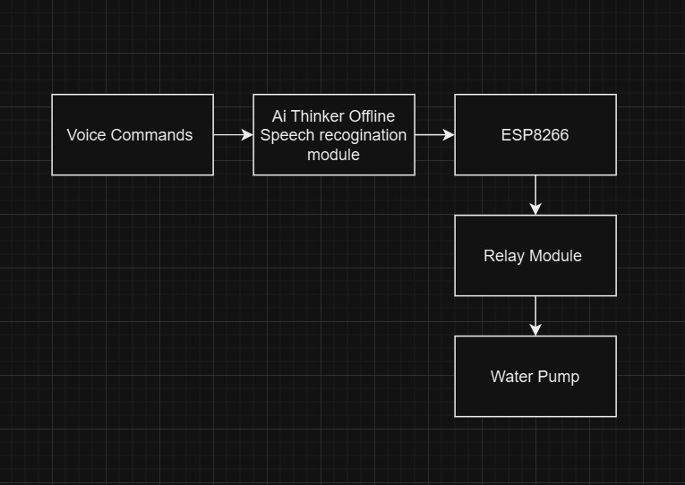
Fig : Block Diagram

Slide 7
Conclusion & Future Scope
Summary of Key Findings (What did you achieve?)
Successfully built a voice-controlled water dispenser using ESP8266 and voice recognition module.
Demonstrated hands-free operation for dispensing hot and cold water based on voice commands.
Achieved a low-cost and user-friendly solution ideal for homes, hospitals, and public use.
Proved the concept of integrating IoT and smart automation in daily appliances.
Challenges Faced (Difficulties during research)
Difficulty in accurate voice recognition in noisy environments.
Limited range and vocabulary support from the Voice Recognition Module V3.
Issues with relay timing and overheating during prolonged hot water dispensing.
Future Scope (How can this work be improved or extended?)
Add mobile app integration for remote control and water temperature monitoring.
Implement AI voice assistants (like Alexa or Google Assistant) for smarter interaction.
Add temperature sensors and display for real-time hot/cold status.
Introduce water quality sensors for health monitoring.
Design a solar-powered version for energy efficiency and sustainability.

Slide 8
References
1. Mazidi, M. A., & Naimi, S. – The 8051 Microcontroller and Embedded Systems – Basics of embedded system design using microcontrollers.
2.John Catsoulis – Designing Embedded Hardware – Interfacing hardware modules with microcontrollers.
3.ESP8266 Datasheet and Documentation https://www.espressif.com/en/products/socs/esp8266
4.Voice Recognition Module V3 – Arduino Guide https://create.arduino.cc/projecthub/muhammad-aqib/voice-recognition-module-v3-60a24b
5.ESP8266 with Arduino IDE – Getting Started Guide https://randomnerdtutorials.com/how-to-install-esp8266-board-arduino-ide/
6.Research Paper on IoT-Based Automation Systems (IEEE Xplore) https://ieeexplore.ieee.org/document/9154456

Slide 9
Thank you...!
“Smart, Hygienic, and Efficient Water Dispensing with Just a Voice Command !”

